Slide 1
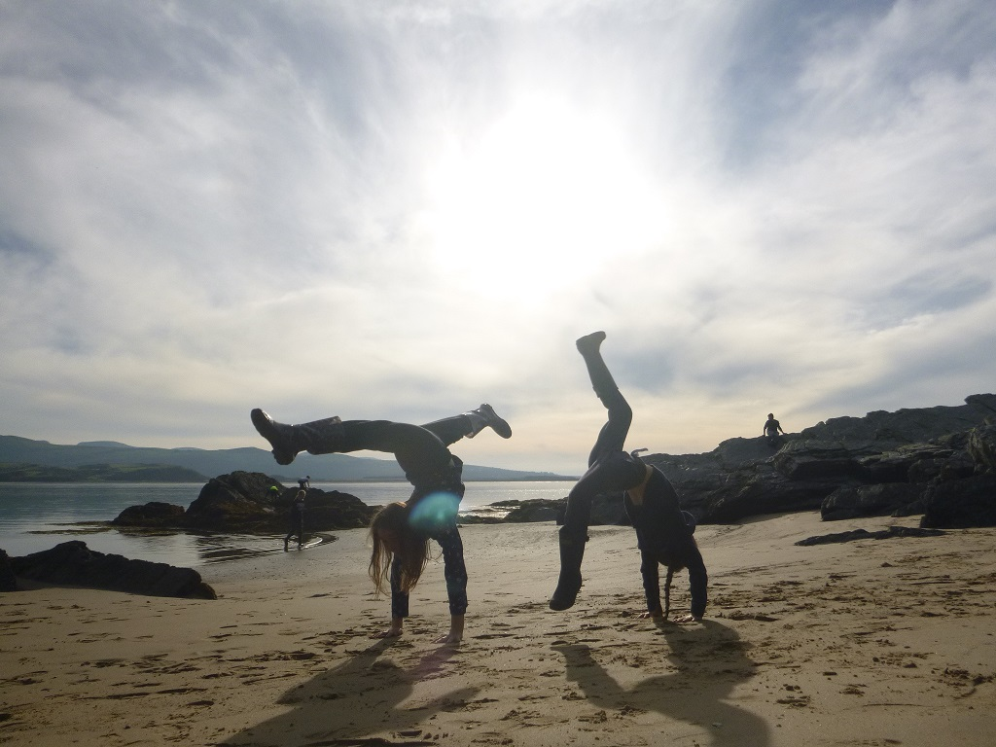

PLAS GWYNANT OUTDOOR EDUCATION CENTRE
Monday 15th September – Friday 19th September 2025

Slide 2

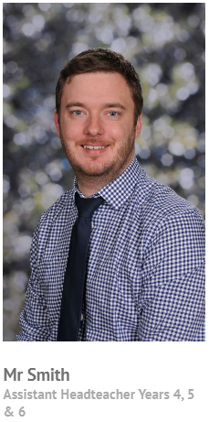
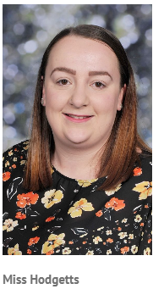
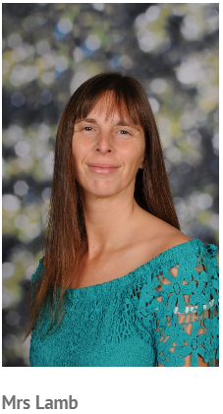
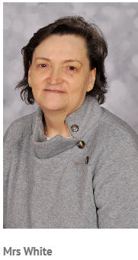
TEMPLE MEADOW STAFF ATTENDING THE VISIT

Slide 3
TEMPLE MEADOW – KEY MESSGAES
On Monday morning, children should arrive at school promptly at 08:30. This allows pupils and staff an hour to check all required items have been packed and that any medication is safely stored.
The coach will leave at 09:30. Please make sure your child brings a packed lunch in a lunch box. Pupils will then use this lunch box all week. Pupils should also have a re-usable, robust water bottle with them.
When we arrive, a text message will be sent from school to let you know we’re there safely. As well as when we set off on the Friday to let you know the time of arrival back at school.
Children aren’t allowed to bring any electrical items such as mobile phones or smart watches. School will contact parents if needed.
Temple Meadow staff will take extra snacks with them on the visit, to be distributed to pupils at appropriate times of the week. Therefore, pupils should not bring any food items with them.
The school website will be updated daily with photographs to let you know what we’ve been up to.
Medication can be brought and will be administered by Temple Meadow staff – this is subject to appropriate parental consent.
Non-prescribed medication will be available during the period of the visit, should pupils have a headache/other mild symptoms that require treatment. Pupils will be assessed by Temple Meadow first-aiders before any medication is administered. Parental consent will be required for non-prescribed medication. A consent slip will be returned and retained, confirming the type of medication that you give consent for Temple Meadow staff to administer. Medication available will be liquid paracetamol and liquid anti-histamine.

Slide 4
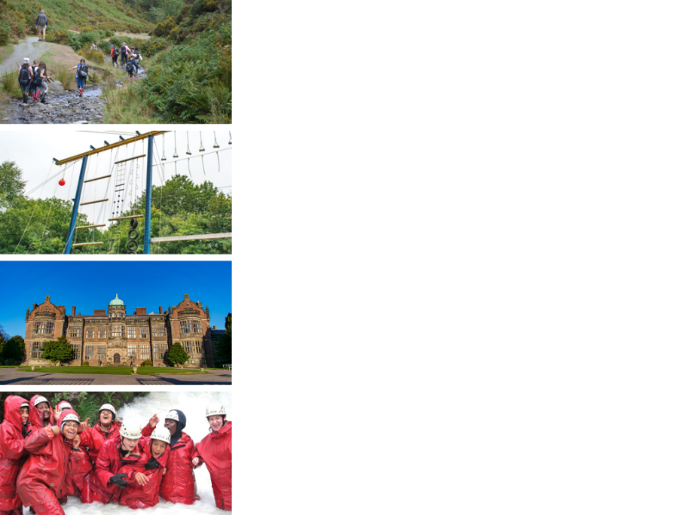
ABOUT SANDWELL RESIDENTIAL SERVICE
4 SUPER VENUES
Edgmond Hall Shropshire
Frank Chapman Centre Wyre Forest
Ingestre Arts Staffordshire
Plas Gwynant Snowdonia
HOME FROM HOME
Small, welcoming centres. Have the place to yourselves!
TAILORED PROGRAMMES
A real learning experience:
The programme is designed with school.
THE HIGHEST STANDARDS
14,000 pax p/a from across the UK

Slide 5
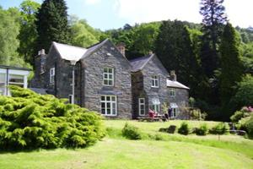

PLAS GWYNANT: CENTRE FACTS
Location
A beautiful lodge set in its own parkland at the foot of Snowdon.
Nant Gwynant, Caernarfon, LL55 4NR
Outside
Lots of safe space to play in grounds, and direct access to the mountains, rivers, lakes and beaches of the National Park.
54 beds
Dorms of 2 to 8
Groups of 40+ have sole occupancy
Inside
Comfortable social space, review rooms, and games room for a perfect residential stay.

Slide 6
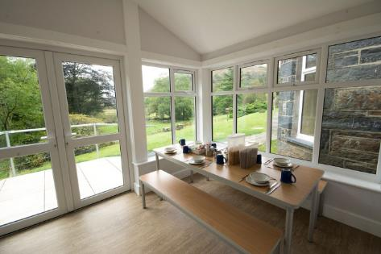
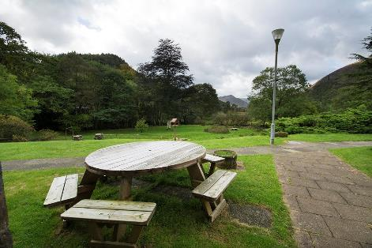
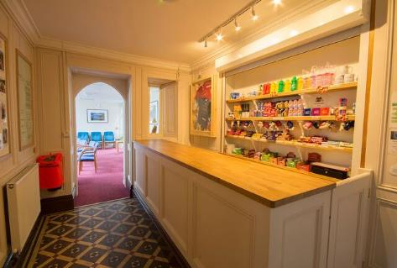
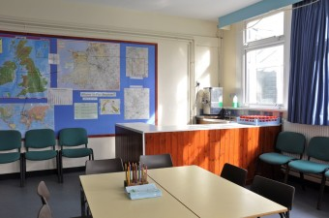
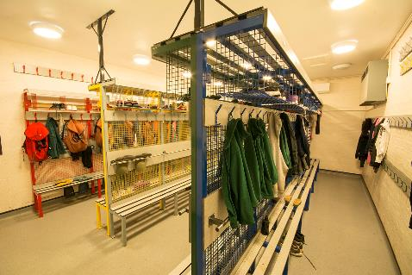
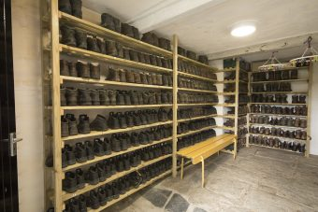




PLAS GWYNANT

Slide 7
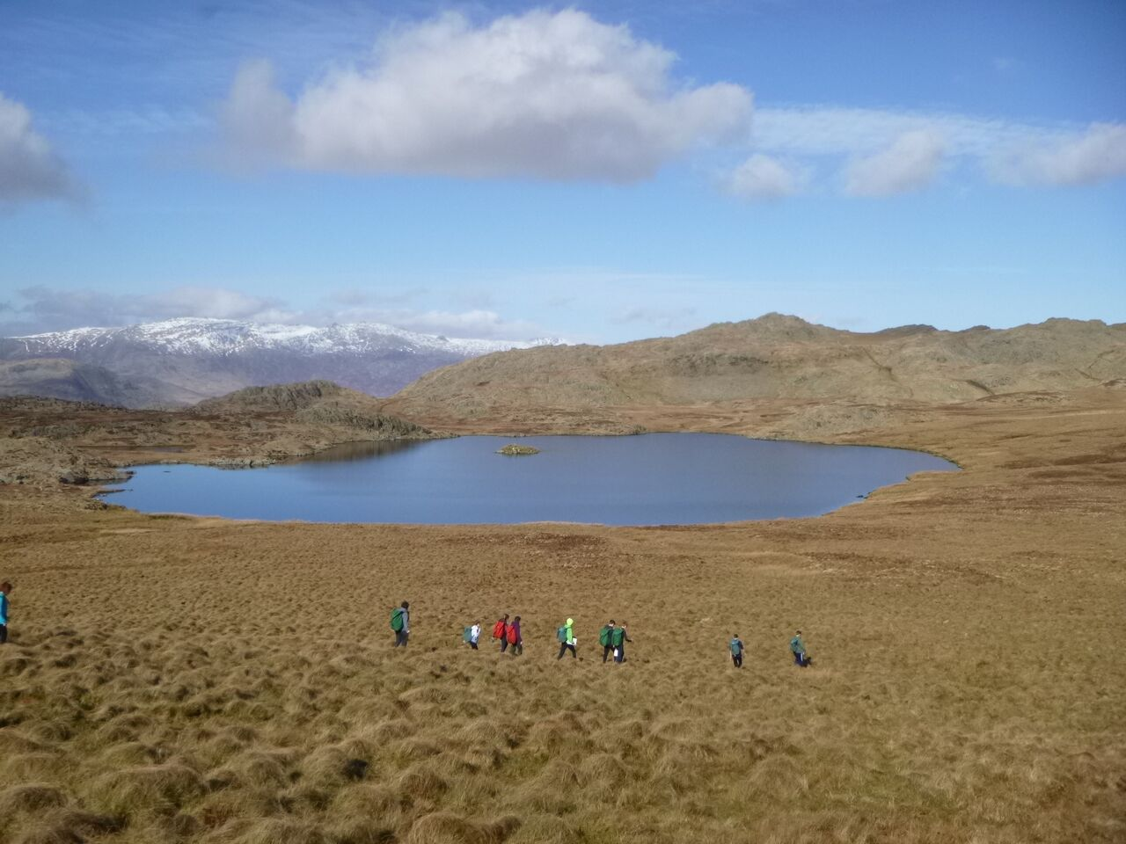
Notes:
Place: the more you immerse a young person – the more memorable it is, the more impactful the experience

Slide 8
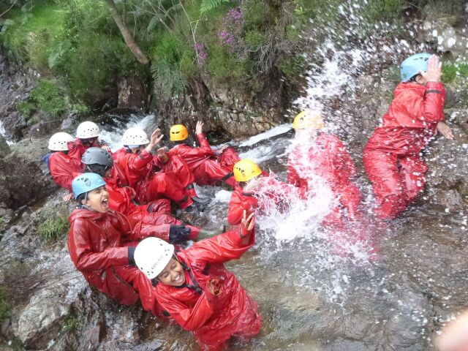
Notes:
Learning through experiences

Slide 9
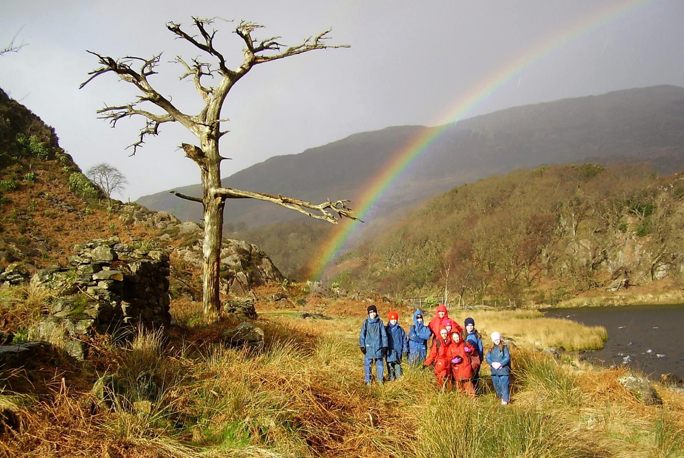
Notes:
Memorable

Slide 10
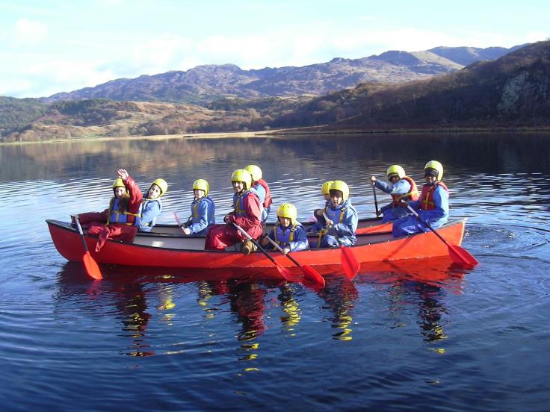
ACTIVITIES
At Plas Gwynant we offer an exciting range of adventurous outdoor activities that make the best use of the surrounding environment.
Tailored to the individuals, activities are all about challenging yourself, trying something new, and learning through experiences.
Activities include:
Rock Climbing
Abseiling
Gorge Walking
Kayaking
Raft Building
Environmental Based Activities
Mountain Biking
Orienteering

Slide 11
A DAY FULL OF FUN
A TYPICAL DAY AT PLAS GWYNANT:
The day starts for pupils at 07:15.
Breakfast is served at 08:20
After eating breakfast, pupils will make a packed lunch.
Pupils will return to dormitories to prepare for their day.
Pupils leave the centre at 10:00 – some activities require minibus transport.
If pupils are on a half-day activity, they will return to the centre at lunchtime, eat their packed lunch and then depart for their second half-day activity.
If pupils are on a full-day activity, pupils will eat their packed lunch whilst at the activity.
All pupils arrive back on site around 16:15.
At 17:30, pupils will eat their evening meal.
At 19:30, pupils will take part in an evening activity. This will be at the residential centre with no transport required.
All pupils will be allocated a job. Different jobs will require completion at different times of the day. These will be explained to pupils when at the centre.

Slide 12
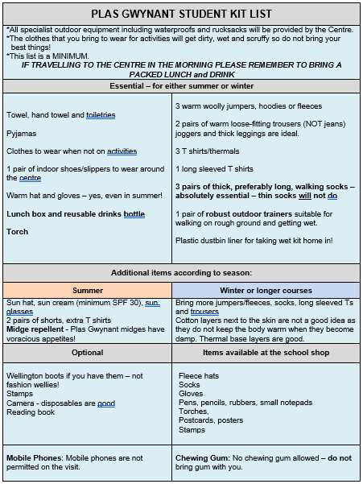
WHAT TO PACK

Slide 13
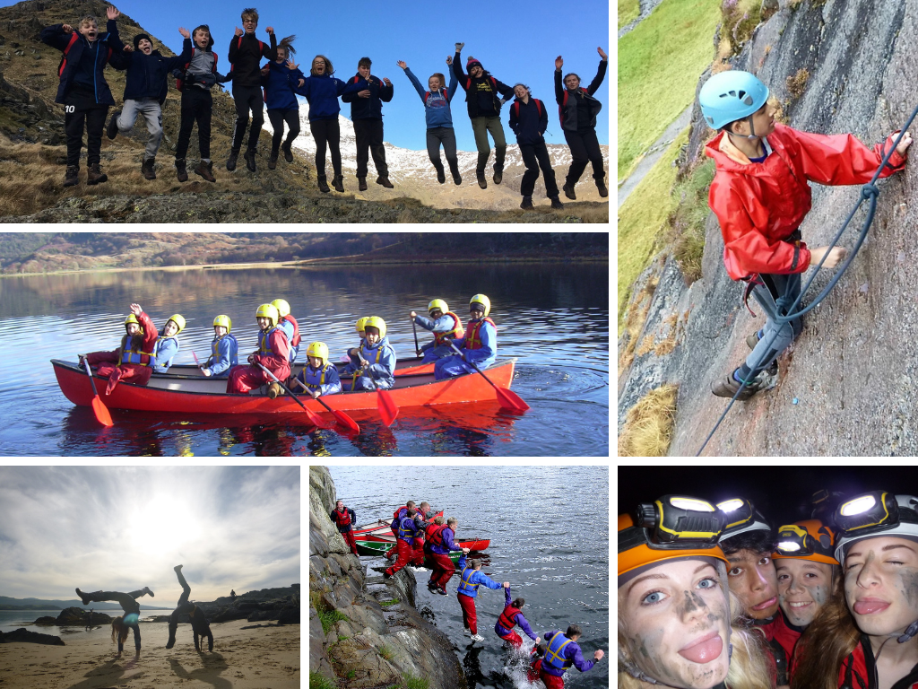

Slide 14
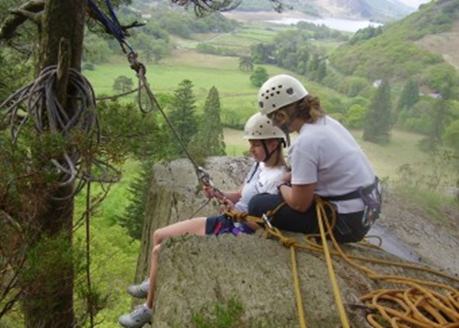
LEARNING
The Plas Gwynant team have technical skill to deliver adventurous experience and, crucially, the soft skills to help every young person achieve more than they ever expected.
We are specialists in residential experiences, and know how valuable it can be.
Tailored Programmes
Every visit is unique. The team work with school and the pupils to shape an exciting, fun, and valuable visit to Plas Gwynant
Group sizes are 10 students to 1+ Plas Gwynant tutor supported by school staff.

Slide 15
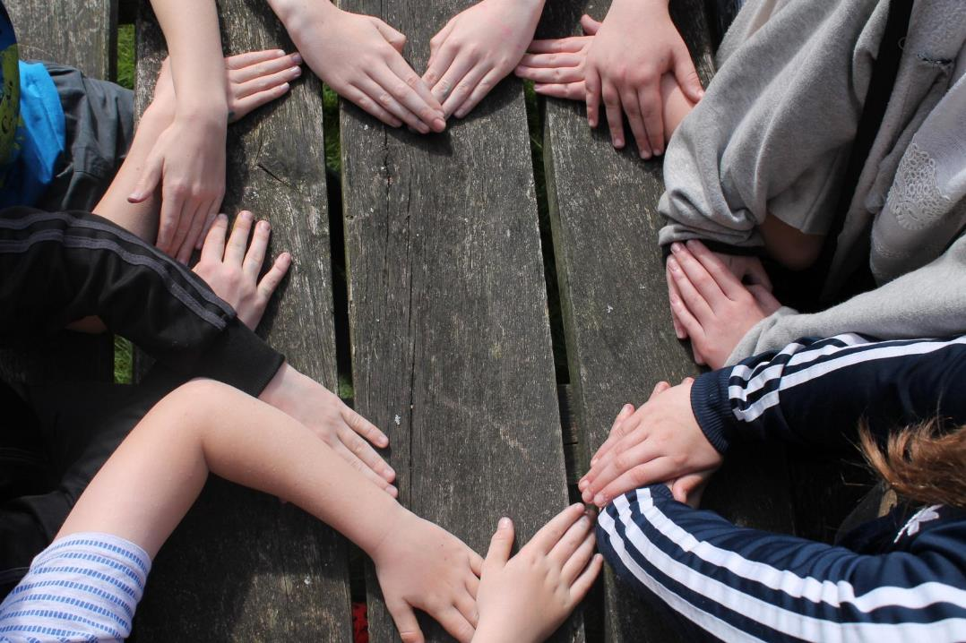


To watch my students transform before my eyes into a new version of themselves - that was amazing!
Assistant Headteacher - Sandwell

Slide 16
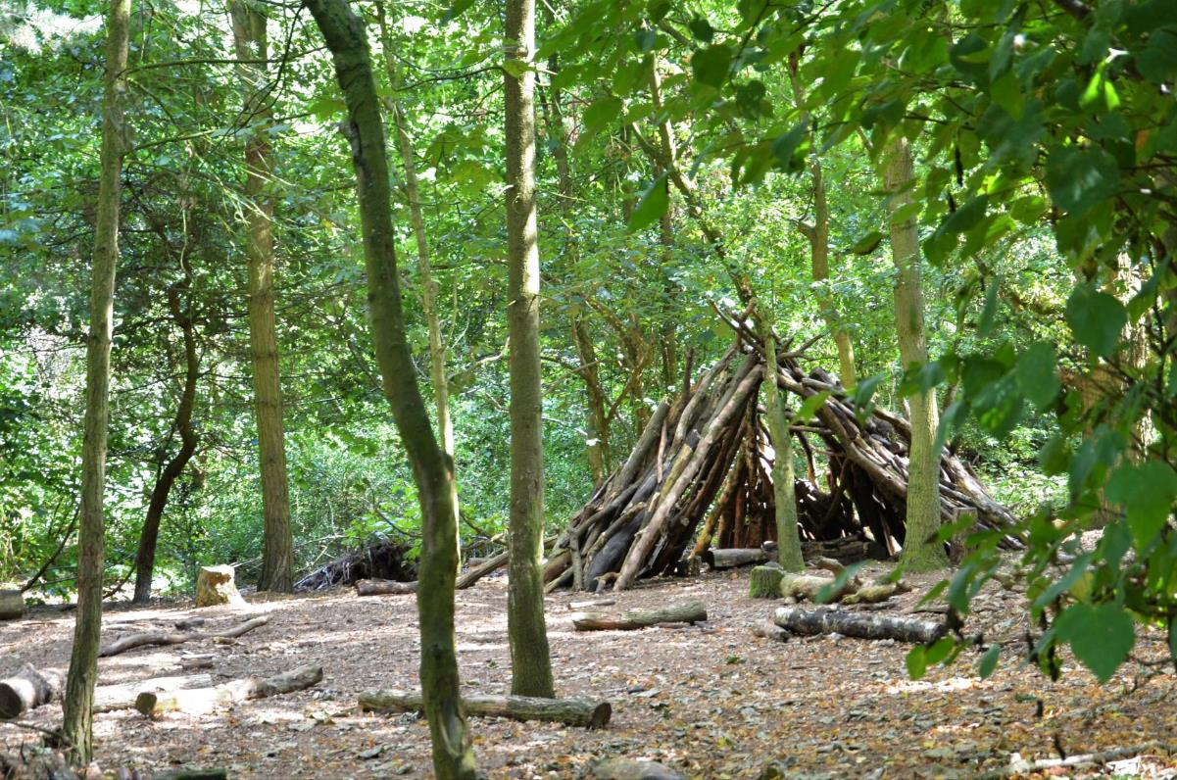
We have seen a real change in the progress and achievement of our children. Their confidence has increased exponentially. This has translated in the classroom into a better attitude for learning and greater confidence in taking part in whole class activities.
Assistant Headteacher - Staffordshire

Slide 17
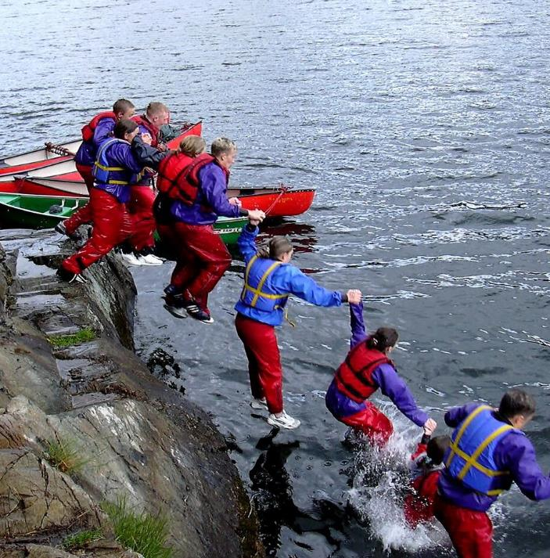
WHY GO TO PLAS GWYNANT
A YOUNG PERSON’S PERSPECTIVE
Try out exciting activities like rock climbing, canoeing and gorge walking
Explore an amazing new place
Make new friends and get to know your classmates even better
It’s an adventure! Go beyond your comfort zone and be open to new experiences
Develop skills, discover passions, boost confidence
Notes:
Teacher perspective:
Everyone who stays at Plas Gywnant gets a warm welcome and the centre soon becomes a home away from home
Develop independence & critical thinking skills
Trying new things and sticking at them
Boost cohesion and sense of belonging
All inclusive – no hidden extras
School and centre staff work as one team to provide the best experience

Slide 18
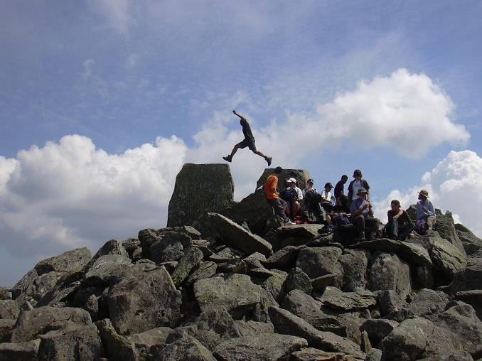
WHY GO TO PLAS GWYNANT
A PARENT’S PERSPECTIVE
Everyone who stays at Plas Gywnant gets a warm welcome and the centre soon becomes a home away from home
Develop independence & critical thinking skills
Trying new things and sticking at them
Boost cohesion and sense of belonging
All inclusive – no hidden extras
School and centre staff work as one team to provide the best experience
Notes:
Young people’s perpective:
Try out exciting activities like rock climbing, canoeing and gorge walking
Explore an amazing new place
Make new friends and get to know your classmates even better
It’s an adventure! Go beyond your comfort zone and be open to new experiences
Develop skills, discover passions, boost confidence

Slide 19

THE EVIDENCE
LEARNING AWAY – BRILLIANT RESIDENTIALS
Compelling 5 year research that shows a residential experience can:
Improve students’ engagement with learning
Support students’ achievement
Improve resilience, self-confidence & wellbeing
Smooth transition

Slide 20
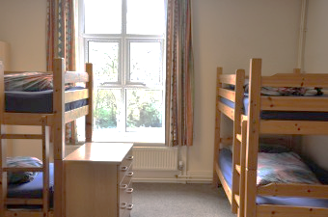
BEDROOMS
We have 54 beds in comfortable dormitories.
Rooms sleep between 2 and 8 pupils
Groups of 40+ have sole use of the centre
All bedding is provided.
Pupils sleep in gender separated areas
Showers and toilet facilities are nearby
Teacher rooms are nearby and centre staff are on hand to provide 24 hour on-site support.

Slide 21
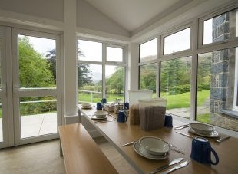

FOOD GLORIOUS FOOD
Home cooked food
We cater for all dietary requirements
Plenty of choice and variety
Example meals:
Lasagne with salad & garlic bread
Vegetable curry with rice & naan
Toad in the hole with mash & veg
Fish fingers & chips
Tuna pasta bake
Main meals are at dinner time with a lighter choice in the afternoon for lunch.

Slide 22
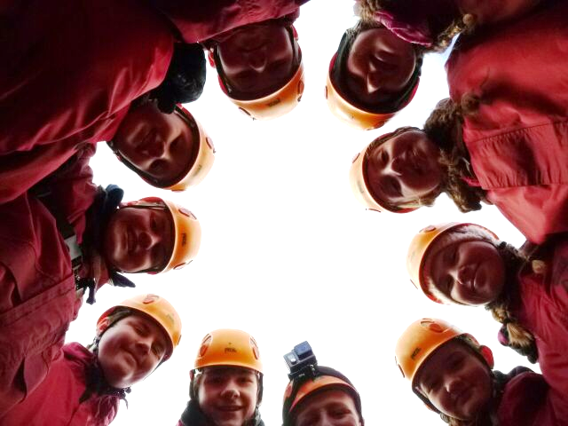
WE CAN’T WAIT TO SEE YOU!
sandwellresidentials.co.uk

